Slide 1
Blinkit Sales And Revenue Report
By Soheb Mulla

Slide 2
Objective
To streamline the order-to-delivery pipeline by identifying and removing time-based bottlenecks to enhance the customer experience.
Identify key revenue-driving factors and understand customer behavior patterns.
To analyze repeat purchase patterns and customer feedback to increase brand loyalty and maximize long-term revenue from existing clients.

Slide 3
Questions
What is the Day wise growth rate in total revenue?
Which top products are generating 80% of the revenue?
Add & Analyze Item Category (Beverage, Snack, Meal)
Which City/Area has the highest total sales?
Compare total sales between weekdays and weekends.

Slide 4
DATASET

Slide 5
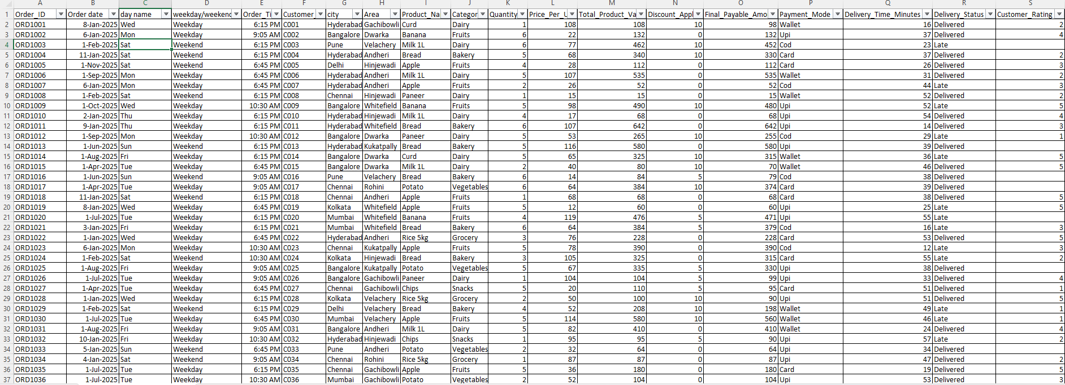

Slide 6
CHARTS

Slide 7
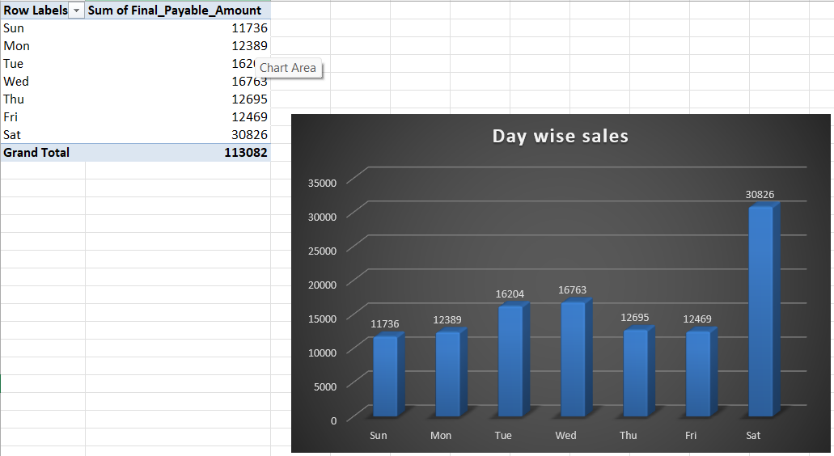
Day wise Revenue

Slide 8
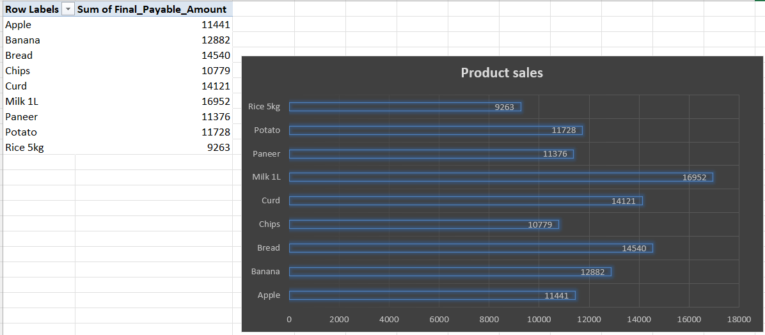
Product sales

Slide 9
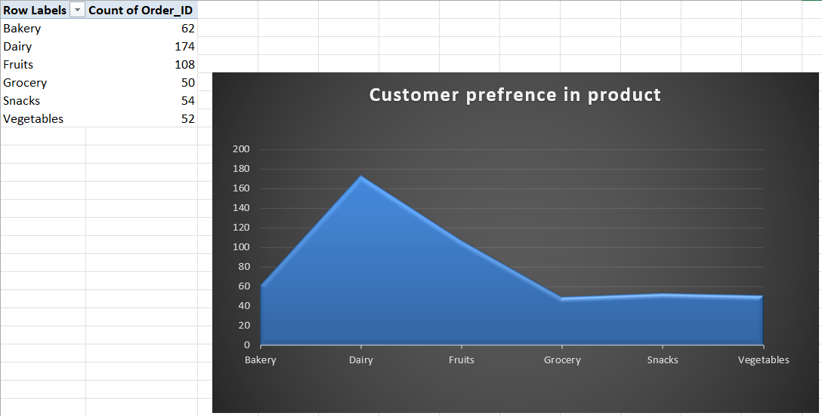
Customer preference in product

Slide 10
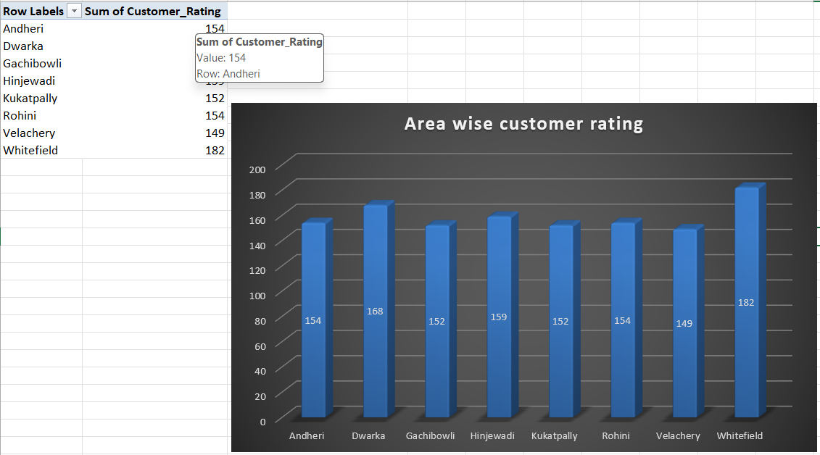
Area wise Customer rating

Slide 11
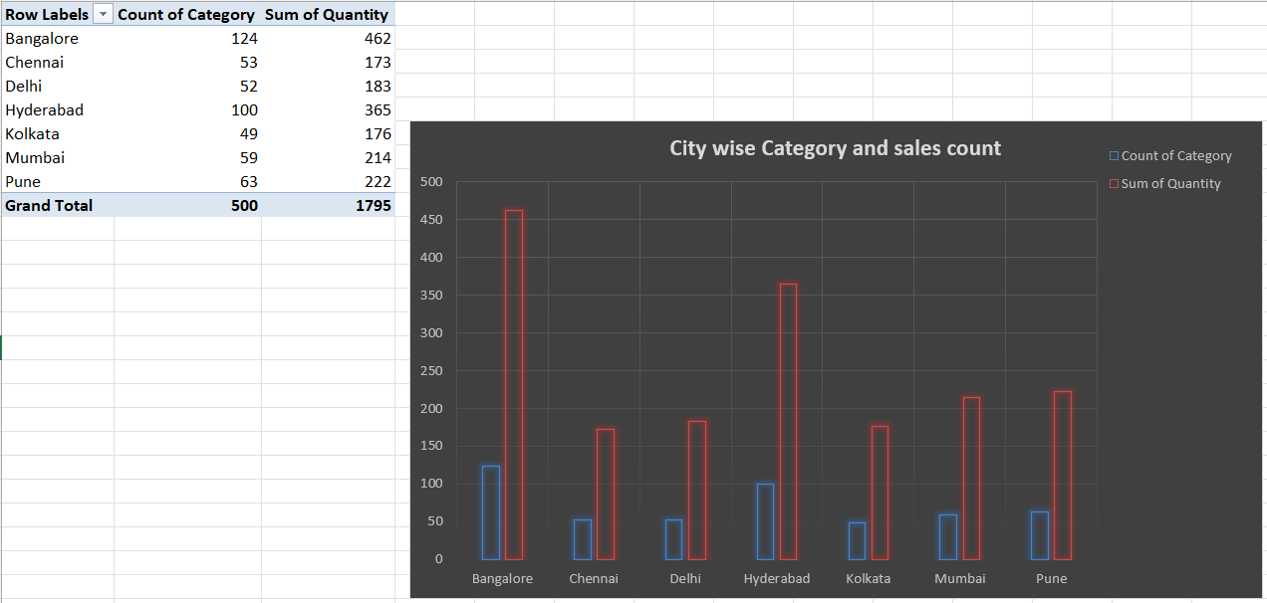
City wise category and sales count

Slide 12
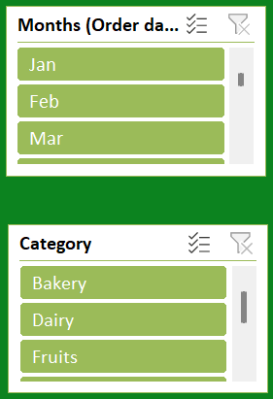
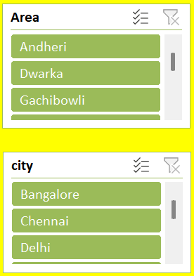
SLICERS

Slide 13
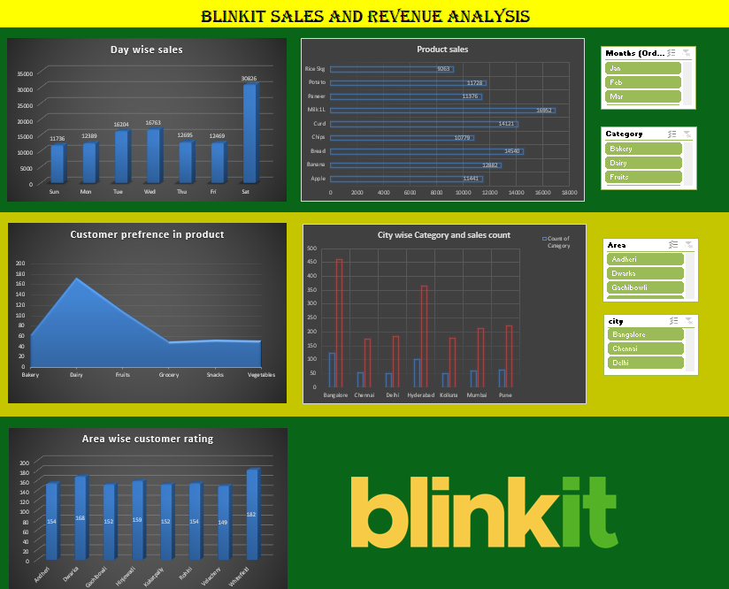
FINAL DASHBOARD

Slide 14
INSIGHTS

Slide 15
$37.54\%$
$37.54\%$
$37.54\%$
These "dense" areas typically represent your peak sales periods or your highest-selling product categories.
Cross-reference these dense clusters with your timeline to identify "Golden Hours" or "Peak Seasons" for resource allocation..
Meal items generate the highest revenue – ₹42,449 in total sales, contributing nearly % of overall revenue.

Slide 16
Top 3 items are Milk, Bread and curd contributed ₹46,616 in sales.

Slide 17
CONCLUSION

Slide 18
There is an omnipresent error rate or "pending" status across the dataset. While not catastrophic, these are "leaks" in the sales funnel. If you can resolve the issues represented by those orange markers, you could potentially convert that $37.5\%$ into $45\%$ or higher.
This indicates a high concentration of value. Whether this represents a specific region, a top-performing product category, or a select group of "Power Users," nearly 40% of your success is driven by this single segment.
"Strategic focus should remain on the 37.5% segment, as it serves as the primary engine for organizational growth.“

Slide 19
THANK YOU !!

